Slide 1
RabbitMQ Exchange
Programming Palli

Slide 2
RabbitMQ Exchange
In RabbitMQ, an exchange is a message routing mechanism that determines how messages should be distributed to queues.
Producer never delivers a message straight to a message queue.
It makes use of exchange as a routing middleman.

Slide 3
Role of RabbitMQ Exchange
RabbitMQ’s exchange is used as a routing mediator.
To receive messages from producers and push them to message queues according to rules provided by the RabbitMQ exchange type.
Each exchange type uses a separate set of parameters and bindings to route the message.
Clients get the option to create their own exchanges or use the default exchanges.

Slide 4
RabbitMQ Exchange Types
Direct Exchange
Topic Exchange
Fanout Exchange
Headers Exchange

Slide 5
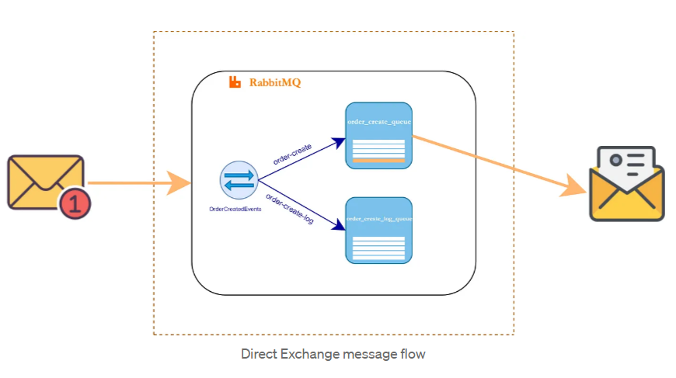
Direct Exchange
The routing in direct exchange is simple.
Message goes to the queues whose binding key exactly matches the routing key of the message.

Slide 6
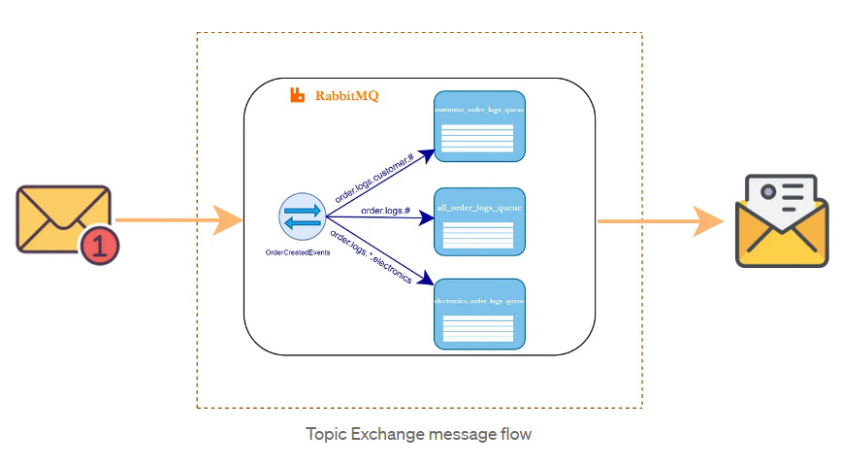
Topic Exchange
Topic exchange is similar to direct exchange.
The routing is done according to the routing pattern.
Instead of using fixed routing key, it uses wildcards.
Messages are routed to one or many queues based on a matching between a message routing key and pattern.
order.*.*.electronics or order.logs.customer.#

Slide 7
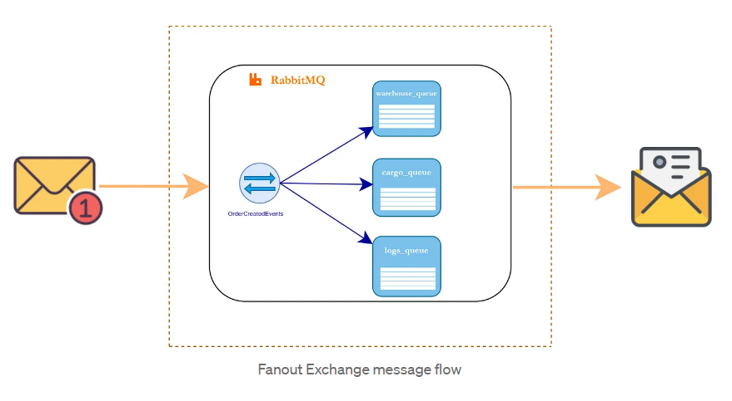
Fanout Exchange
A fanout exchange copies and routes a received message to all queues.
The keys provided will simply be ignored.
For example, when an order is created, the warehouse needs to be notified so it can prepare the order, also the cargo company needs to be notified, a consumer wishing to keep logs of orders also needs to be notified.

Slide 8
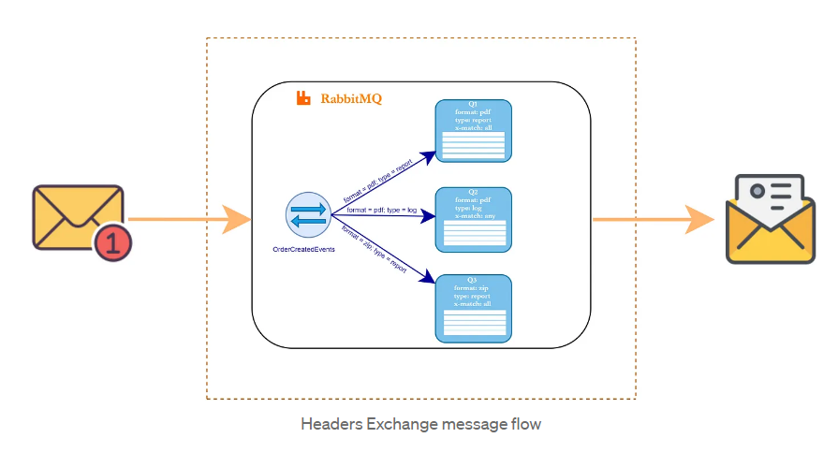
Header Exchange
A headers exchange routes messages based on arguments containing headers and optional values.
It uses the message header attributes for routing.

Slide 9
More Exchange Types
Default Exchange: The default exchange is a pre-declared direct exchange that has no name. It is usually referred by an empty string. If you use default exchange your message is delivered to the queue with a name equal to the routing key of the message. Every queue is automatically bound to the default exchange with a routing key which is the same as the queue name.
Dead Letter Exchange: If there is no matching queue for the message, the message is dropped.

Slide 10
Question?

Slide 11
Thank You
Please subscribe

